Slide 1
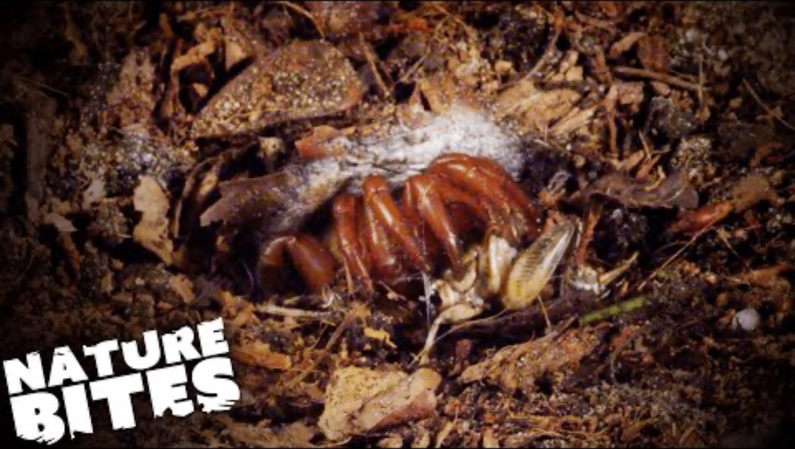
Emma E. Jochim, James Starrett, Hanna R. Briggs, Jason E. Bond. 2025. "Speciation Pattern and Process in the California Coastal Dune Endemic Trapdoor Spider Aptostichus simus (Mygalomorphae: Euctenizidae) and Description of a New Cryptic Species" *Ecology and Evolution* 15:e72346 <https://doi.org/10.1002/ece3.72346>.
Class focus area: Review of some of what we’ve learned
Nature Bites, BBC. https://www.youtube.com/watch?v=7n2M9TqbaM4
EEB603: Brian O’Meara
All quotes and images from the above paper unless otherwise noted

Slide 2


Slide 3
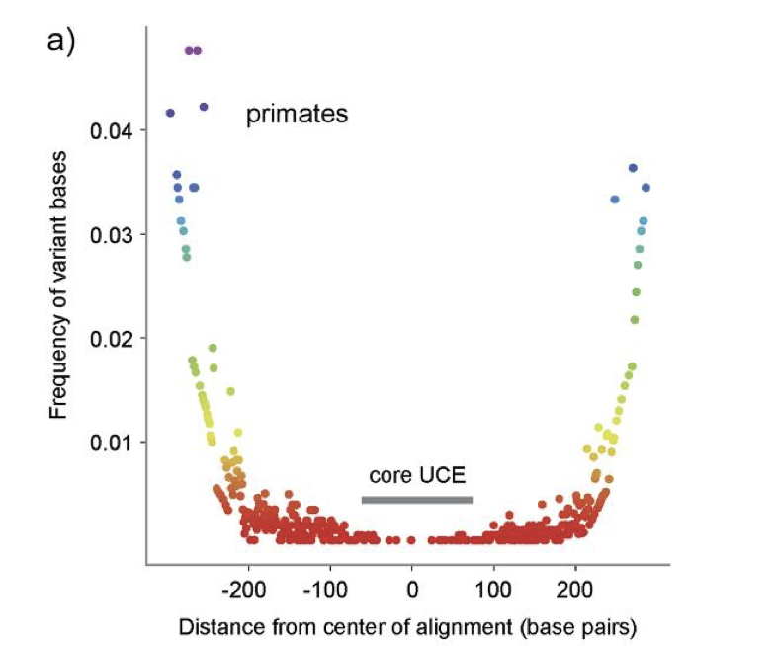
Faircloth et al. 2012

Slide 4
Too hot
Just right
Too cold
Faircloth et al. 2012

Slide 5
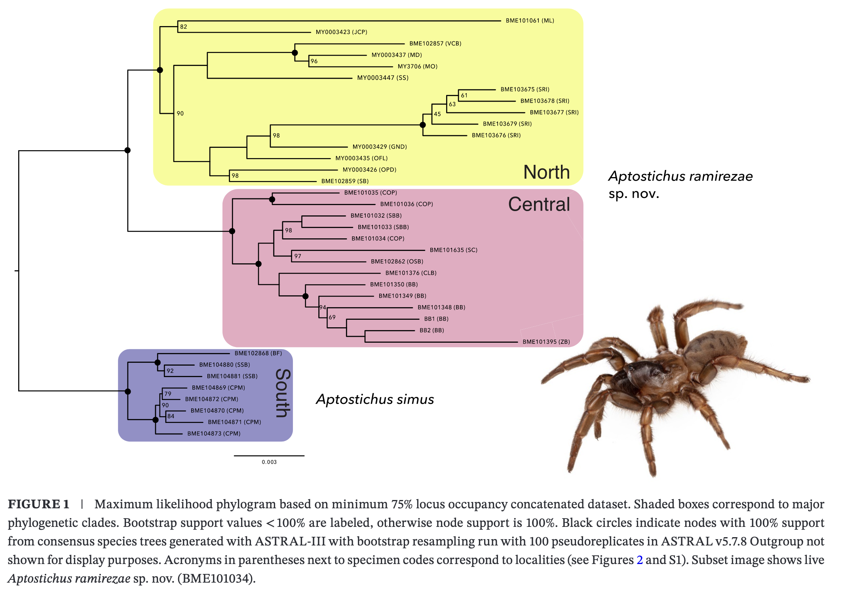

Slide 6
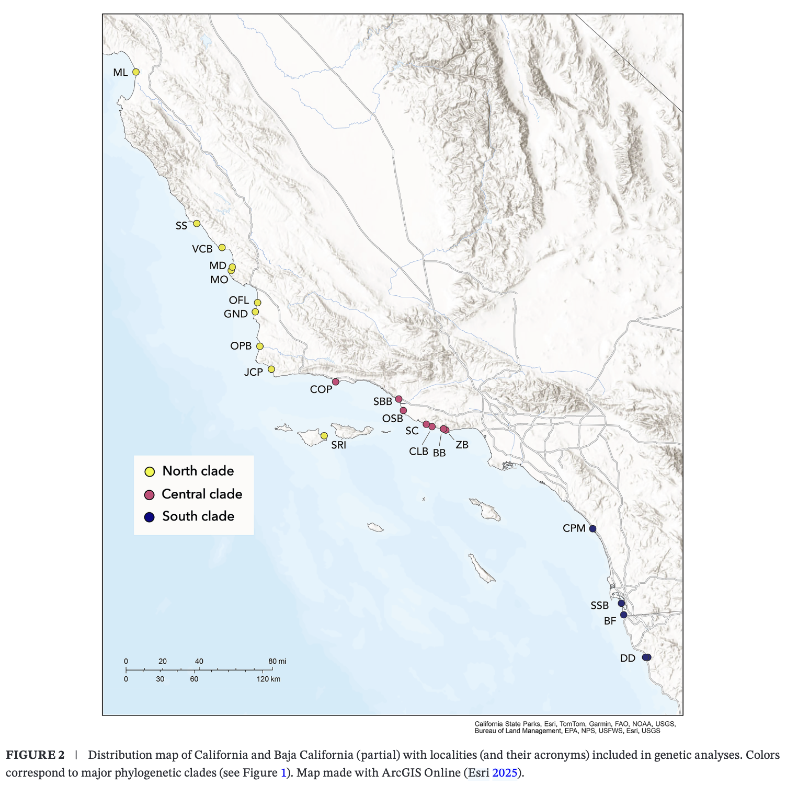

Slide 7
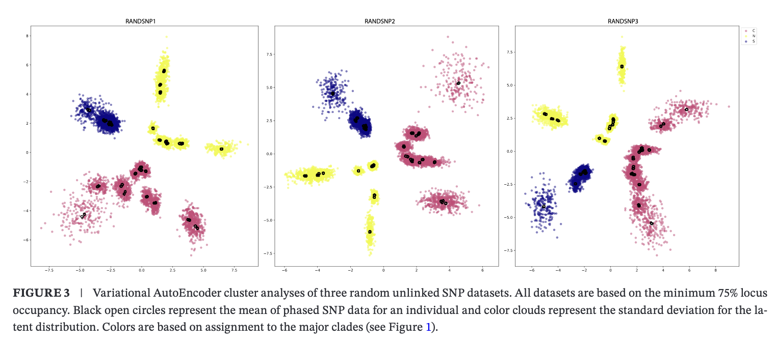

Slide 8
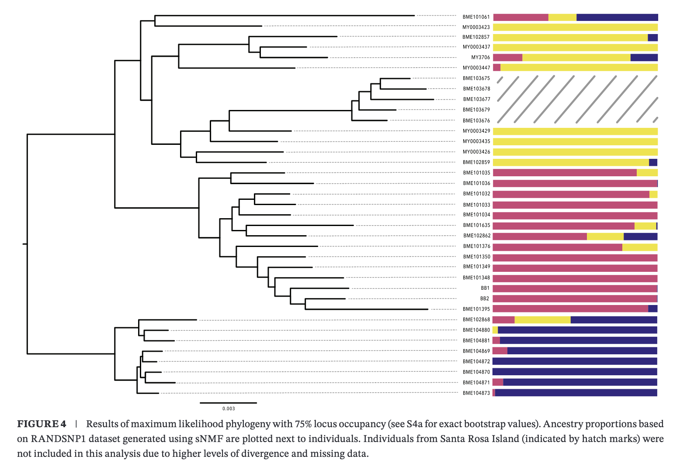

Slide 9
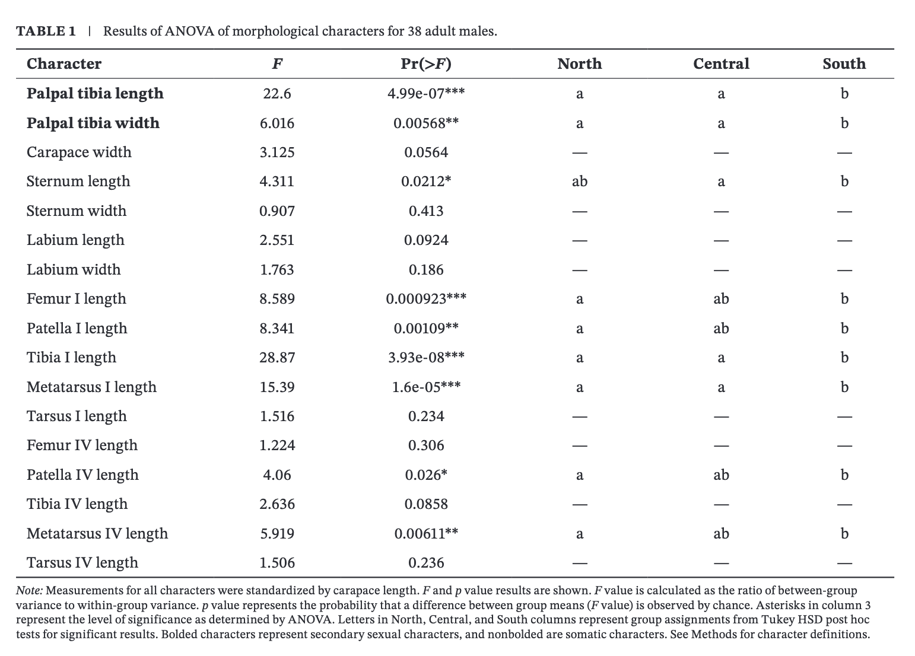

Slide 10
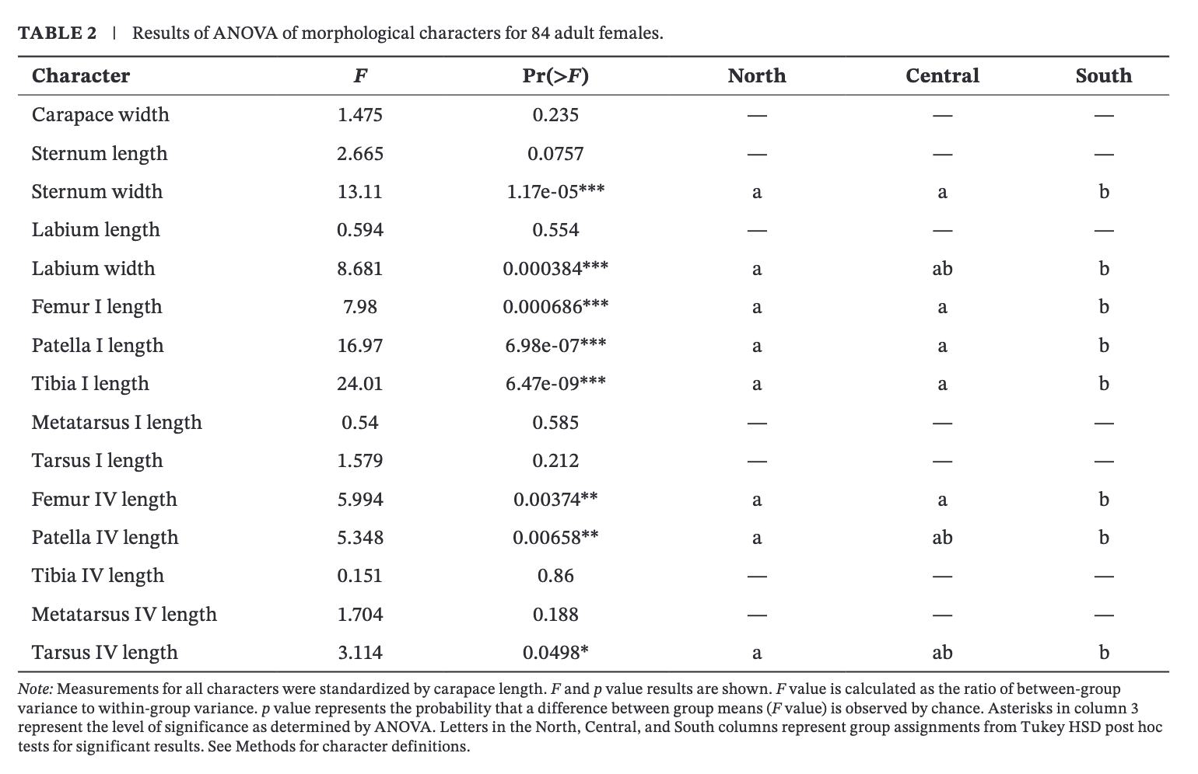

Slide 11
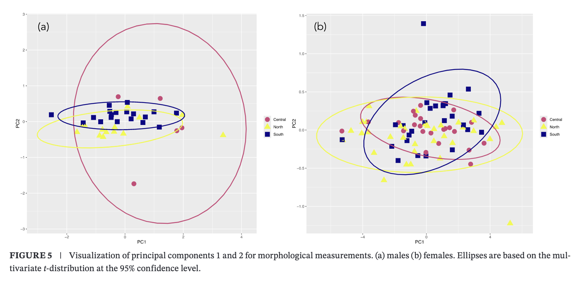

Slide 12
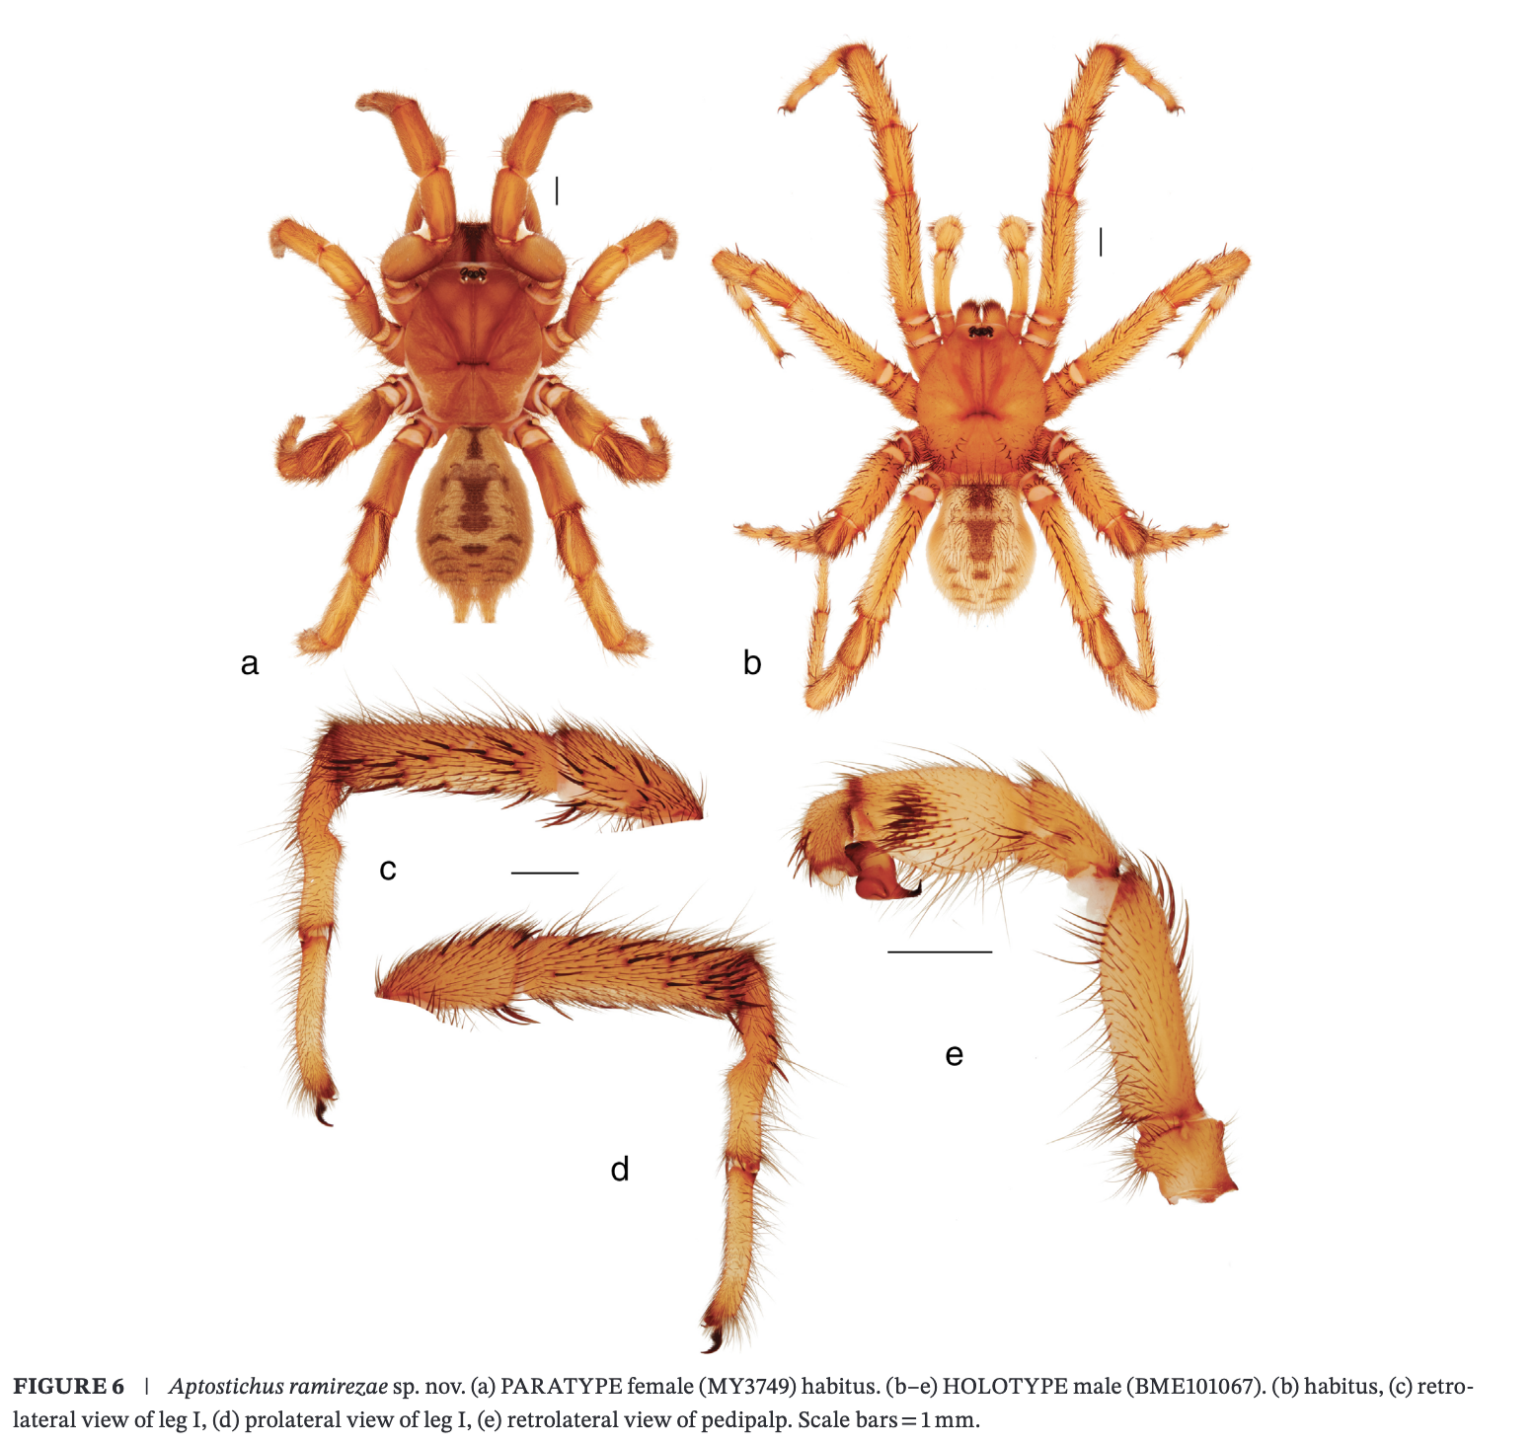

Slide 13
Cohesion species concept?
What does the new species mean, ethically and legally?
What caused the speciation event?
What is an ultraconserved element?
How important is sample size?
How do we know the morphological differences aren’t plastic?
What does locus occupancy mean?
This may be just a me issue, but whenever I see PCA's I feel weird. Like I understand what is going on and why people do them (they are pretty and fun to look at), but I get a bit concerned when people start to make bold claims about them (e.g. the circles don't overlap so the two groups are different) without running some type of stats on them (like an RDA). Or just treating PC axes as the most biologically meaningful. Is it just a thing with morphology (or other fields of high dimensionality) to do a PCA and not worry about the stats behind it?
Why do trapdoor spiders bring me so much joy?
What was the purpose of RANDSNP? What is ABBA-BABA? VAE analyses? Hardy-Weinberg?
When do you need an outgroup?
The only thing I find a bit complex is naming a new taxon when you don't have enough morphological characteristics to recognize it in the field. It doesn't seem entirely viable or practical. But one thing I like about this approach is the idea that we should conserve genetic diversity (not the diversity of species as such).
Naming species after people? After living people?
I am not an animal person, but I am interested in how they get the DNA sample from the specimens. Like they get the DNA from the legs, but do they have to kill the spider to do that?

